Slide 1
Performance Tuning Pit Stop for DBAs
Ayman El-Ghazali
Senior Consultant @ Microsoft
@TheSQLPro
TheSQLPro.com

Slide 2
The Goal
Make your system faster with as little downtime and with the least amount of impact in terms of re-architecture/re-coding
Or simply, become a PerfTuning Ninja
Test Twice, Don’t Break Production Once

Slide 3

Agenda
Check Engine, Baseline with PAL Tools
Files Files Files & FileGroups
Configuration of TempDB
IFI,VLF, WTH? And other Acronyms
Other Considerations

Slide 4
Check Engine Light
Power Settings in OS and BIOS
Check SQL Max Memory Settings
Should leave 10% or more to the OS OR
1GB Free for OS for each 4GB for the first 16GB of RAM. 1GB Free for OS for each 16GB thereafter. So for a 64GB Server leave 7GB Free which is about 10%.
Other considerations if SSIS/SSAS/SSRS or other services are running
Check disk cluster size (Allocation Units) – 64KB
Auto-Shrink/Auto-Close disabled
Do not disable Auto-Grow of DB/Log files but do not rely on it

Slide 5
Baseline with PAL Tools
Why have a baseline? Because there is always that one annoying person that says “I want proof”
Baselines help you determine the effectiveness of your tuning
Baselines help you determine activity/data growth and this can be used for many things (requesting more hardware, team members, etc)
You can call yourself a scientist afterward

Slide 6
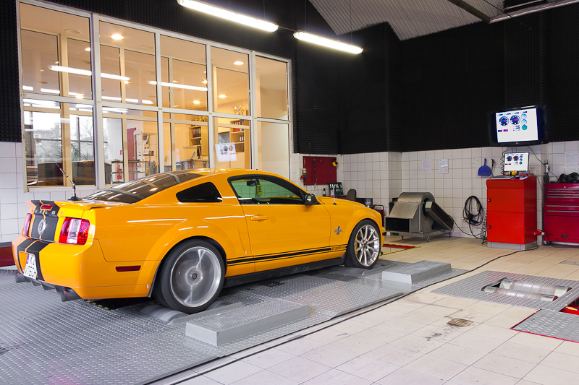
Demo
http://upload.wikimedia.org/wikipedia/commons/0/04/4x4_Dynamometer.jpg

Slide 7
Files Files Files & FileGroups
Modern DBMS has multi-threading capabilities
The DB Engine can take advantage of this to allow multiple working processes to use one or more threads to complete work
File placement, size, and number can make or break performance
Data/Indexes can be distributed across different FileGroups as well

Slide 8
Data Files
Round Robin Proportional Fill-Algorithm
Make sure Data files are equally sized
Make sure that you pre-size your data files in advance
Use separate physical disks when available/appropriate
Separate from Log and TempDB Files; consider this a requirement

Slide 9
Size & Free Space Matters
Record1
Record3
Record1
Record3
Record2
Record4
Record2
Record4
1GB
100% Free
500MB
100% Free
500MB
100% Free
500MB
100% Free

Slide 10
TempDB – Server’s Community Pool
Remember that communal pool that everyone used to go to? Remember what the little kids used to do? Now you’re ready to learn about TempDB.
Multiple files allow for multiple threads to use TempDB
Reduces “System” Page Contention (GAM, SGAM, PFS)
These internal pages help SQL Server allocate/track space for objects such as tables. Therefore when contention is reduced, performance is increased.
Start with 4-8 files, do not exceed 8 unless needed
Pre-size them equally according to your workload
TEST TEST TEST

Slide 11
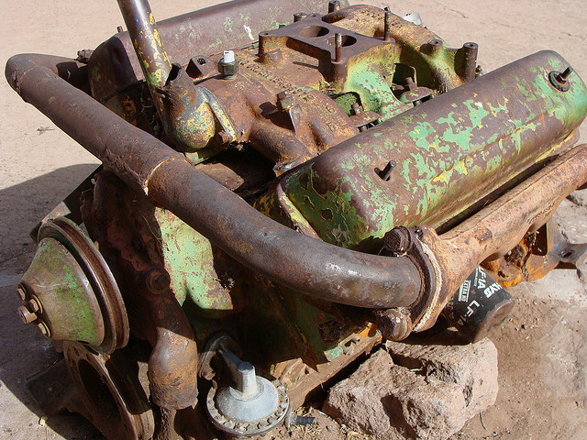
Demo – TempDB and Data Files
https://c2.staticflickr.com/4/3106/2757631695_b05369c491_z.jpg

Slide 12
Instant File Initialization - IFI
What is it?
Prevents database files from “Zeroing Out” or “Zero-Filling” upon creation and growth

Slide 13
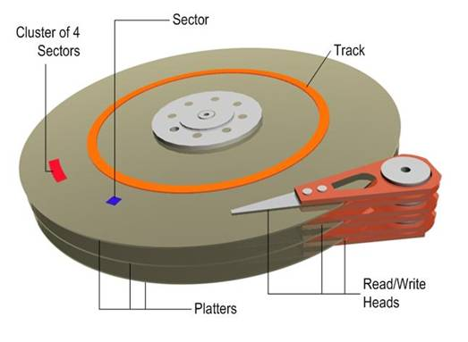
File Deletion vs. File Erasure
00000000000000000000000000000000
“Available”
Image source: http://i.technet.microsoft.com/dynimg/IC306536.jpg

Slide 14
IFI Off vs IFI On
000000000000000000000
00000000000000

Slide 15
Why is it useful?
Makes Database file creation and growth faster
Creating database files faster means that rebuilding TempDB is faster
Occurs with Server restart or SQL Services restarting, potentially speeding up Cluster failovers
Who doesn’t want a performance boost?
Does not affect Log Files, only applies to Data files
Does not work with databases that use Transparent Data Encryption (TDE) and a few other rules

Slide 16
How do you set it up?
Two ways:
The Crazy way – by adding the SQL Server service as an admin on the server. Works but is dangerous!
The Right way – by adding the SQL Server service to the “Perform volume maintenance tasks” security policy
Can be found under Control Panel>Administrative Tools>Local Security Policy
Under Local Policies>User Rights Assignment>Perform Volume Maintenance Tasks
Use Trace Flag 3004 and 3605 to test
3004 shows backup and file creation info; 3605 writes it to the SQL Server Log
DBCC TRACEON (3004,3605,-1)
EXEC sp_readerrorlog – Use this command to read the error log

Slide 17
Virtual Log Files - VLFs
Internal logical structures of Log Files
Can cause major performance problems
Too many - Slow Restores, Inserts, Updates, Deletes, sign of fragmented log file
Excessive Locking
Can slow HA features such as Mirroring/Availability Groups
Too large – T-Log backups can be slow, takes longer to clear
Easy to detect and solve
Pre-Sizing, using regular sized (MB/GB) interval for sizing not percentage
DBCC LOGINFO
Returns # of Records, which is the # of VLFs
Undocumented but well known (aka my disclaimer)

Slide 18
VLF Dissected
T1
T2
T3
T4

Slide 19
VLF Nightmare
What your VLF probably looks like, but not as attractive
Pre-size based on your work load
Growth size determines number of VLFs
How many should I have? It depends!
Too few big VLFs - log backups take longer. Do not exceed 512MB per VLFs
Too many small VLFs - longer recovery, locking issues, etc. Do not exceed 100.
Growth Size | # of VLFs
Less than 64MB | 4 VLFs
64MB – 1GB | 8 VLFs
1GB + | 16 VLFs

Slide 20
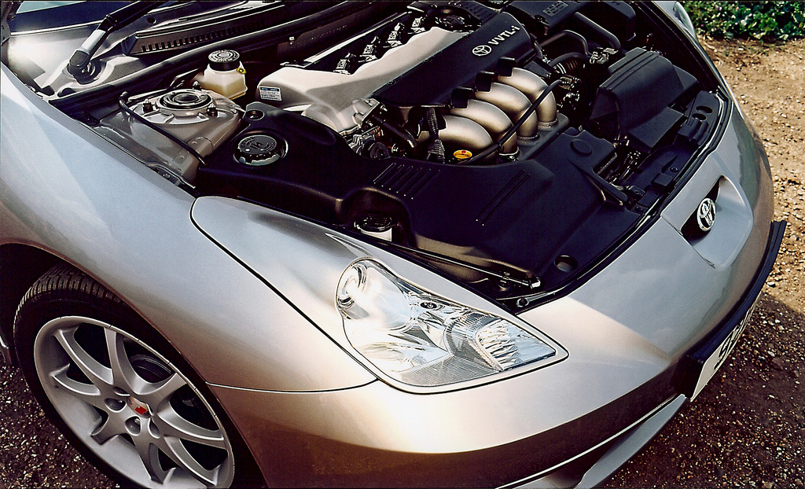
Demo – VLFs and IFI
https://c2.staticflickr.com/8/7364/8723155674_1ae7c47ea9_b.jpg

Slide 21
Other Considerations
Indirect Checkpoints (SQL 2012+), Delayed Durability (SQL 2014+) – Please research
Buffer Pool Extension, In Memory OLTP
Indexes – Clustered, Non-Clustered, Filtered, ColumnStore
Performance Tuning Indexes
Table Partitioning
Setting Read-Only for databases that are loaded nightly
Avoid thin provisioning on Virtual Disks
Compression

Slide 22

Cross the Finish Line!
https://c1.staticflickr.com/5/4133/5036929273_e5de9770b2_z.jpg

Slide 23
Q&A

